Slide 1

Project 2025
02.09.25 - 05.09.25

Slide 2
Technical Assignment 1 / Техническое задание 1
Creative Project for the Metal Grid Stand
Разработка проекта для стэнда из металлической решетки
Project Goal:
Develop a creative IT-oriented concept project that transforms the existing metal grid stand (as shown in the photo) into an interactive installation or design solution. The project should stimulate creativity by integrating technologies to enhance visitor engagement, such as data visualization, interactive elements, or augmented reality. The focus is on innovative use of IT for educational or entertainment purposes related to health, technology (drones), or achievements.
The project can be presented as a concept (description, sketches, presentation) without physical implementation.
Task Description:
Students must devise a concept project that could be an installation (e.g., a dynamic display), an unconventional design solution (with lighting or sensor elements), or a functional solution (e.g., an interactive stand for project demonstrations). The concept should account for the stand's physical structure (metal grid for mounting elements) and integrate IT components such as microcontrollers (Arduino/Raspberry Pi), mobile applications, web interfaces, or AI for data processing.
Project Requirements:
• Creative Aspect
• Technical Requirements:
• Incorporate at least one IT element: software (Python, JavaScript), hardware (sensors, screens, LEDs), or network integration (IoT for remote control). Describe how it would function in the concept.
• Ensure safety: the concept should consider that the project won’t damage the grid, will be energy-safe, and durable for everyday use.
• Scalability: the concept should be easily modifiable for future updates.
• Implementation Stages:
• Idea and concept development (sketches, description).
• Creation of a presentation (visualization, mockups).
• Preparation for demonstration (online presentation).
• Constraints: The project must be completed within 3-4 days as a concept (no physical assembly). The project will be evaluated by a commission on Friday. Participants in project development will receive max 10 points for the practical session.
Students work in teams of 3-5 people. The final project should be submitted as a report, sketches, and an online demonstration.

Slide 3
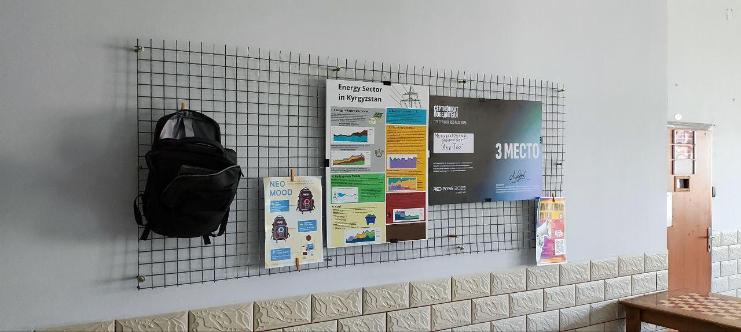
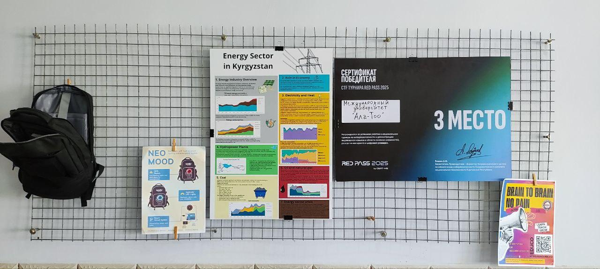
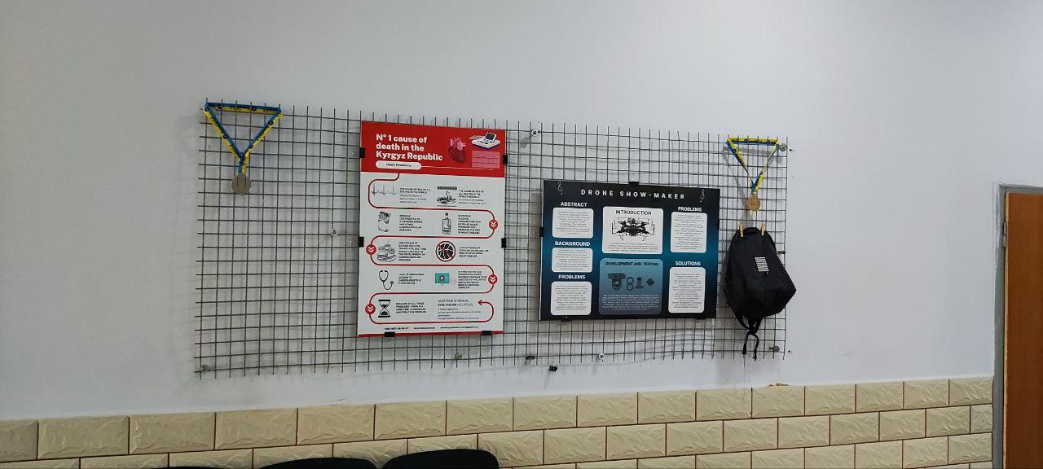
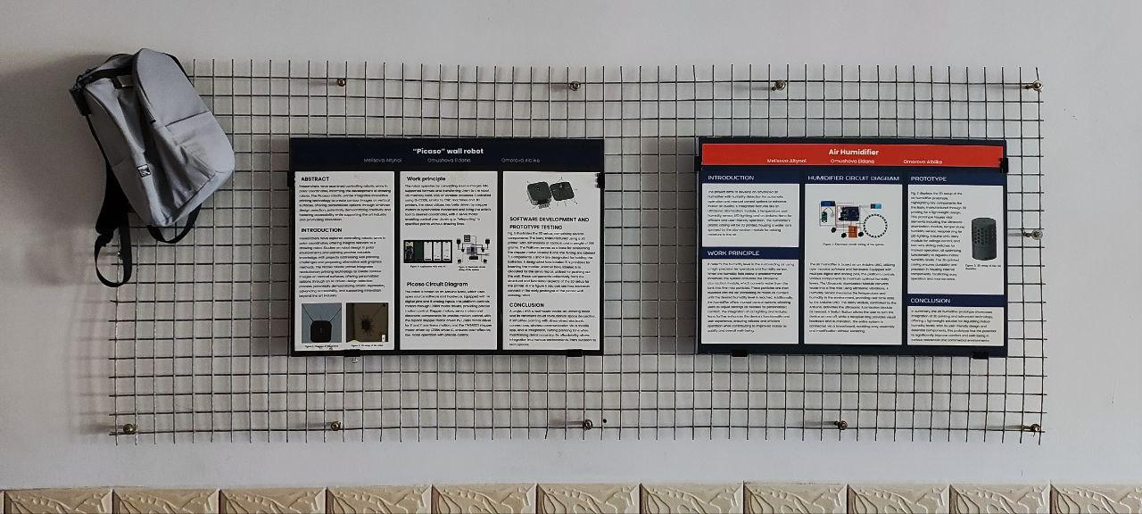
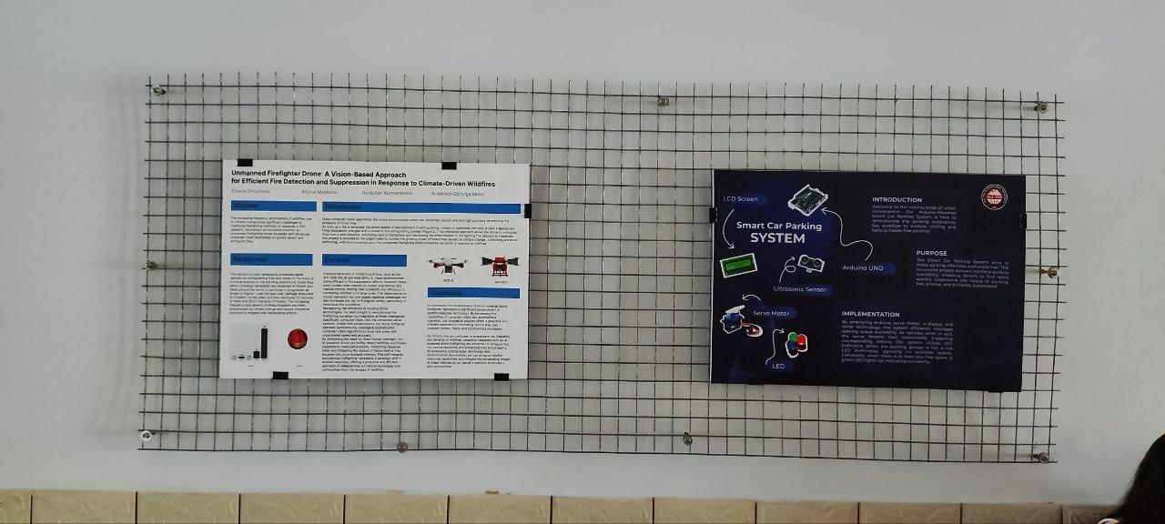
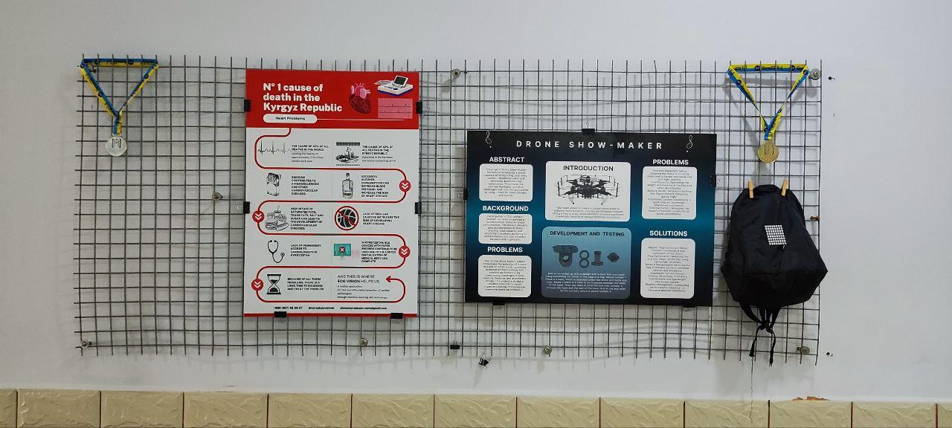
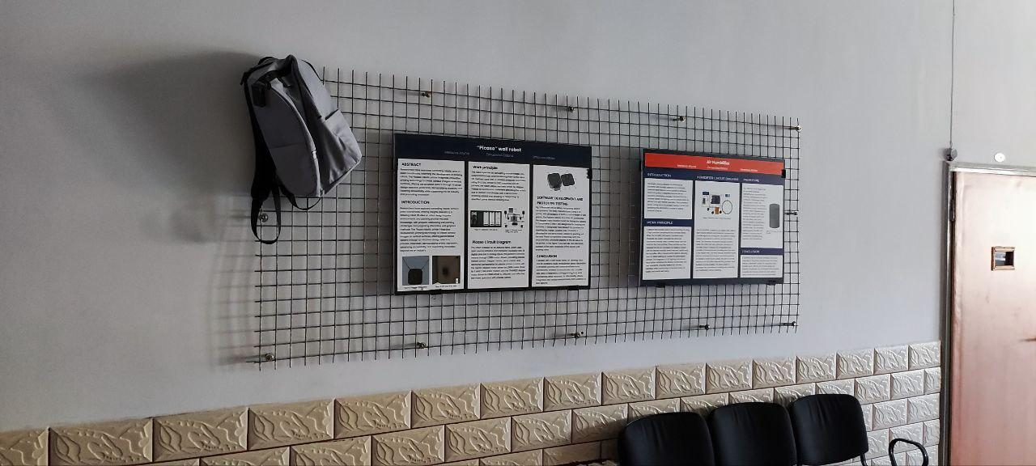
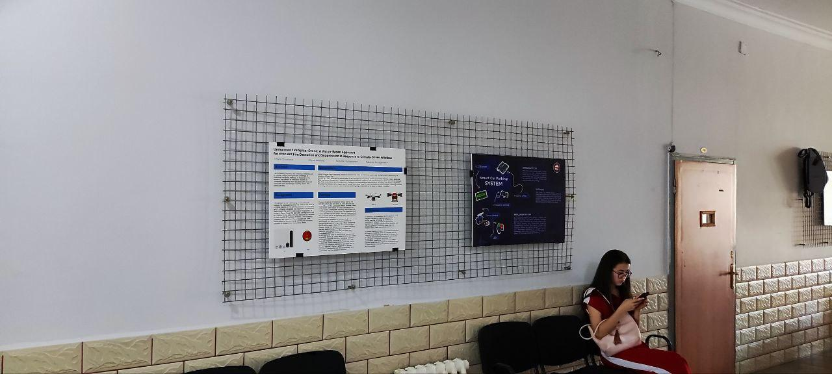

Slide 4
Technical Assignment 2 / Техническое задание 2
Project for the Small Workshop
Разработка проекта для мини-мастерской
Project Goal:
Create a creative IT-concept project for a small workshop (as shown in the photo). The concept should transform the space into an innovative zone for work or learning, encouraging students to develop installations or design solutions using technology. The focus is on creativity: making the workshop "smart" or interactive by integrating elements for collaboration, monitoring, or entertainment. The project can be presented as a concept (description, sketches, presentation) without physical implementation.
Task Description:
Develop a concept project, such as an interactive installation (e.g., a smart wall with touch screens), an unusual design (lighting with AI control), or a space optimization solution (booking system via an app). The concept should consider the workshop’s compactness, glass walls for visual integration, and existing elements (QR codes for enhanced functionality).
Project Requirements:
• Creative Aspect
• Technical Requirements:
• IT integration: use of APIs, mobile/web apps, sensors, or ML for automation (e.g., gesture recognition for door opening). Describe in the concept.
• Space adaptation: the concept should be non-invasive and easily mountable on glass or walls.
• Data security: if user data is involved, ensure confidentiality as described.
• Implementation Stages:
• Space analysis and brainstorming.
• Concept development (sketches).
• Preparation of a presentation.
• Constraints: The project must be completed within 3-4 days as a concept (no physical assembly). The project will be evaluated by a commission on Friday.
Participants in project development will receive max 10 points for the practical session.
Work in teams of 3-5 people. The outcome: a report with sketches and an online presentation.

Slide 5
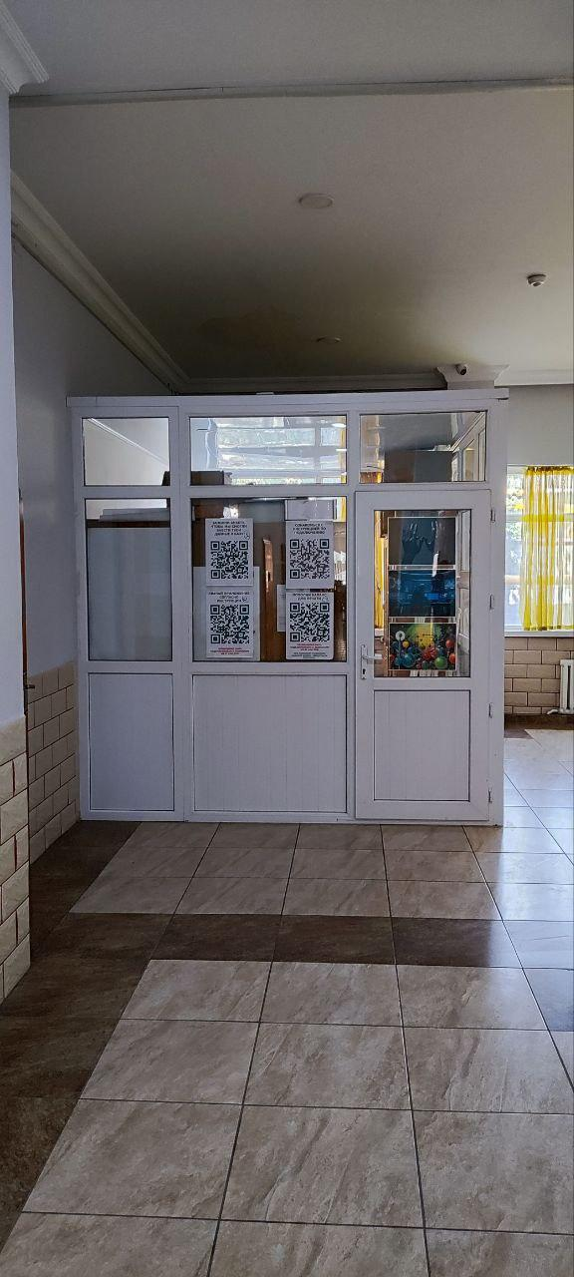
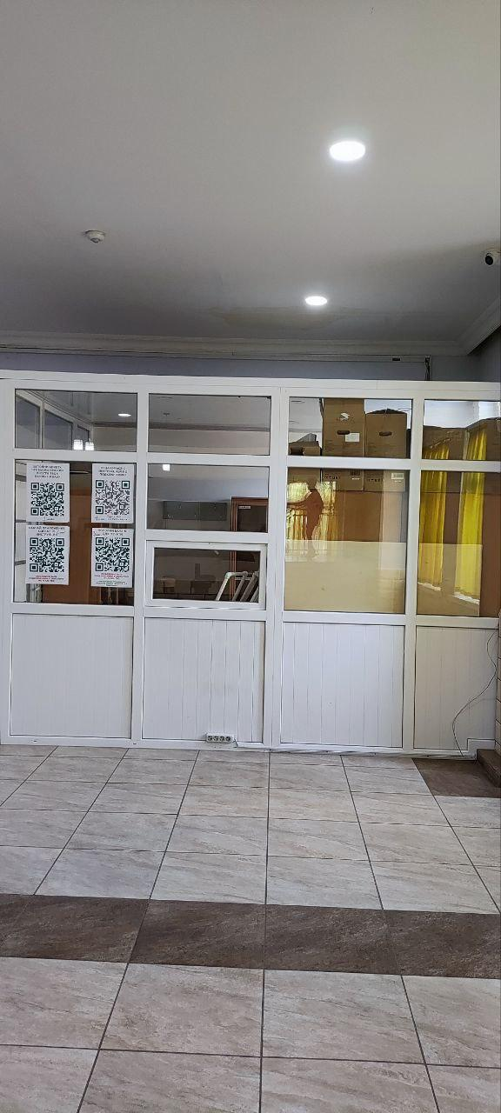
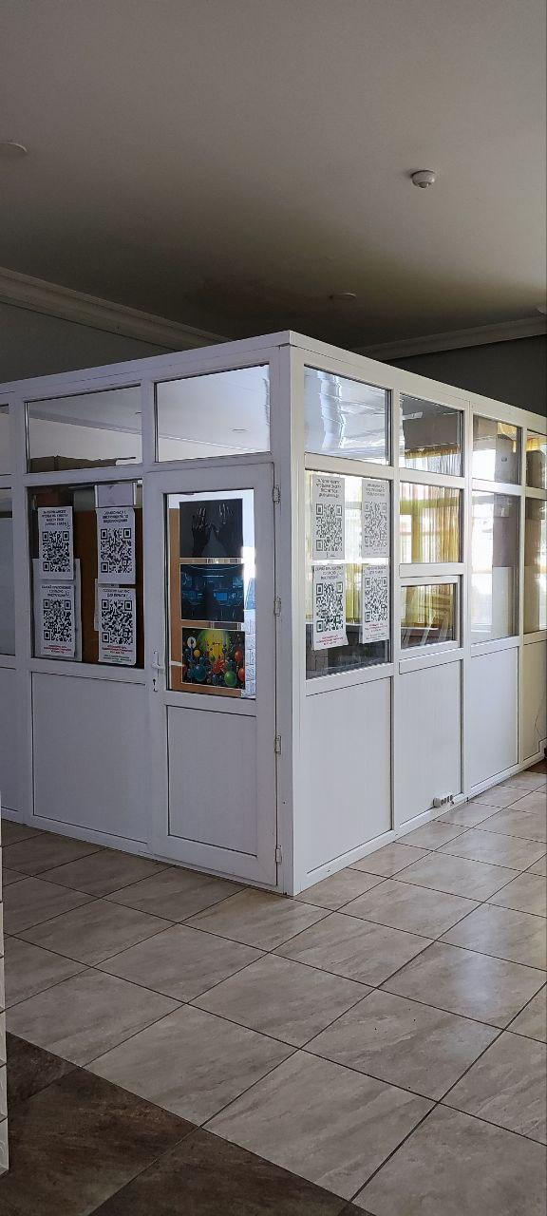

Slide 6
Technical Assignment 3 / Техническое задание 3
Project for the Corner Area
Проект для Креативного уголка
Project Goal:
Develop a creative IT-concept project for the corner area (as shown in the photo: a relaxation zone with bar stools, bookshelves, lighting, and striped walls).
The concept should make the space more appealing and functional, encouraging students to come up with creative ideas such as installations or design solutions for relaxation, learning, or socializing with IT elements. Since the lesson is conducted online, the project can be presented as a concept (description, sketches, presentation) without physical implementation.
Task Description:
Create a concept project, such as an interactive corner with multimedia, an unusual design (dynamic walls), or a comfort solution (smart lighting). The concept should consider the furniture (stools, shelves) for technology integration, making the space "smart" for users.
Project Requirements:
• Creative Aspect
• Technical Requirements:
• IT components: software (apps, scripts), hardware (displays, sensors), network integration for content updates. Describe in the concept.
• Ergonomics: the concept should enhance comfort without cluttering the space.
• Energy efficiency: minimize energy consumption.
• Implementation Stages:
• Concept and design.
• Creation of sketches.
• Preparation for presentation.
• Constraints: The project must be completed within 3-4 days as a concept (no physical assembly). The project will be evaluated by a commission on Friday. Participants in project development will receive max 10 points for the practical session.
Teams of 3-5 people. Final result: an online presentation with a working concept (visualizations).

Slide 7
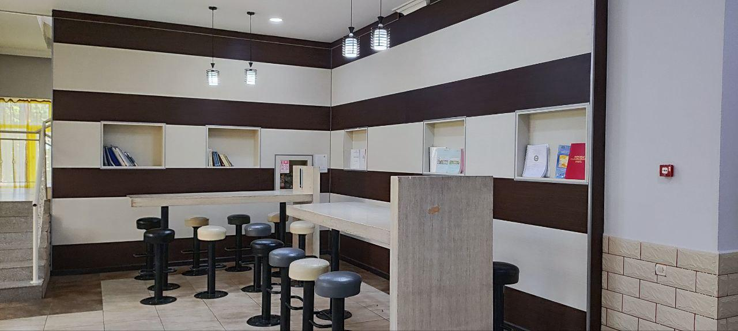
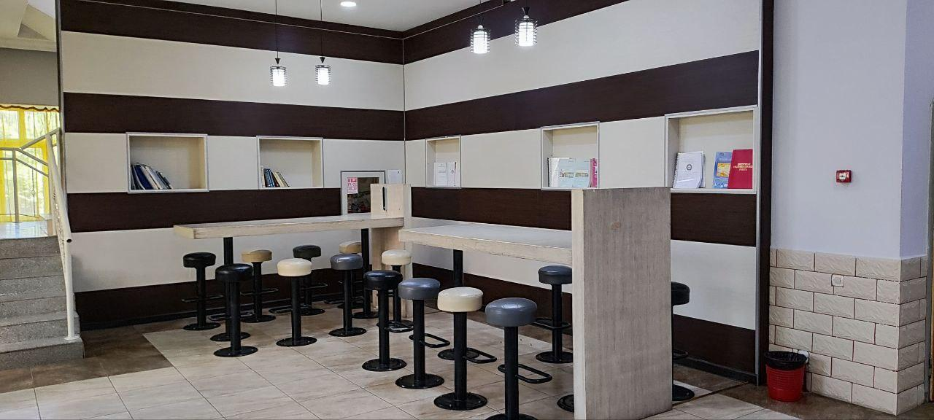
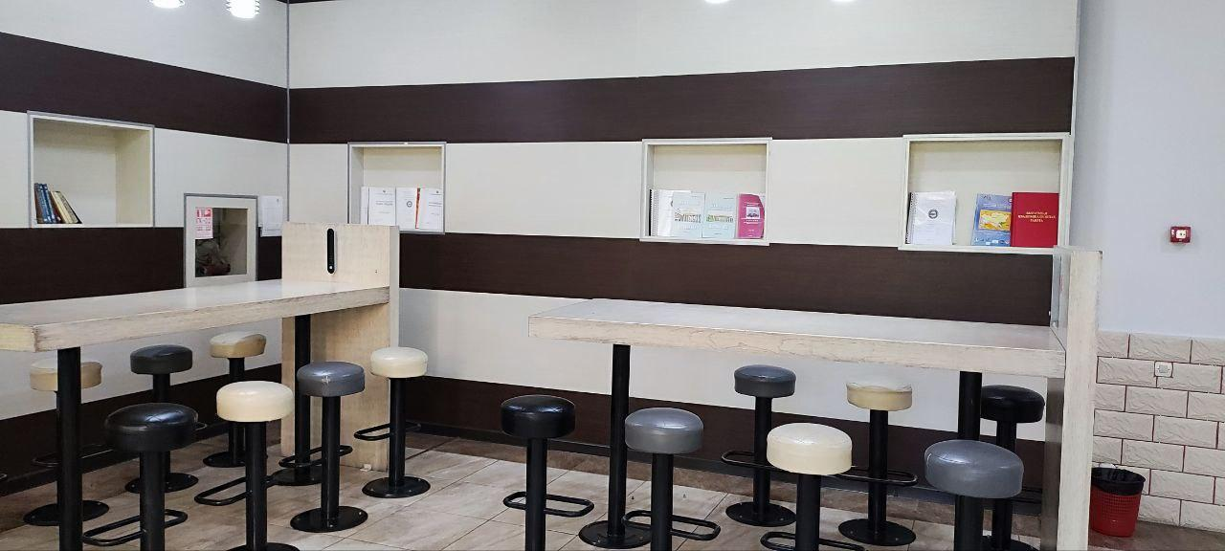

Slide 8
Technical Assignment 4 / Техническое задание 4
Creative Project for Code of Conduct, Fire Safety Rules and Electricity Safety Rules in IT Labs Posters
Разработка дизайна постеров по правилам поведения, пожарной и электрической безопасности в лабораториях факультета
Project Goal
Develop a creative IT-oriented concept project for designing a wall poster on the topics of "Code of Conduct in IT Labs", "Fire Safety Rules in Labs", "Electricity Safety Rules in Labs" to be hung on the metal grid stand . The concept should transform the poster into an interactive or engaging element, stimulating students' creativity by integrating technologies to promote awareness and compliance, such as QR codes, augmented reality, or digital interactivity. The focus is on innovative use of IT to make the code of conduct educational and memorable. Since the lesson is conducted online, the project can be presented as a concept (description, sketches, presentation) without physical implementation.
Task Description
Devise a concept for a poster design that could incorporate interactive features (e.g., scannable elements leading to digital resources), unconventional layouts (with embedded tech visuals), or functional enhancements (e.g., a poster that updates digitally). The concept should account for the stand's physical structure (metal grid for easy hanging) and integrate IT components to enhance user interaction, such as mobile apps, web links, or AI-driven content.
Project Requirements:
• Creative Aspect
• Technical Requirements:
• Incorporate at least one IT element: software (e.g., design tools like Figma or Adobe XD for mockups, Python for generating QR codes), hardware simulations (e.g., sensors for hypothetical interactivity), or network integration (e.g., links to web apps). Describe how it would function in the concept.
• Ensure safety and relevance: the concept should align with lab conduct principles, be visually clear, and suitable for hanging without damage to the grid.
• Scalability: the design concept should allow for easy updates or adaptations to new rules.
• Implementation Stages:
• Idea and concept development (sketches, description of content and IT features).
• Creation of a presentation (visualization, mockups of the poster).
• Preparation for demonstration (online presentation).
• Constraints: The project must be completed within 3-4 days as a concept (no physical printing or assembly). The project will be evaluated by a commission on Friday. Participants in project development will receive max 10 points for the practical session.
Students work in teams of 3-5 people. The final project should be submitted as a report, sketches, and an online demonstration.

Slide 9
